Slide 1

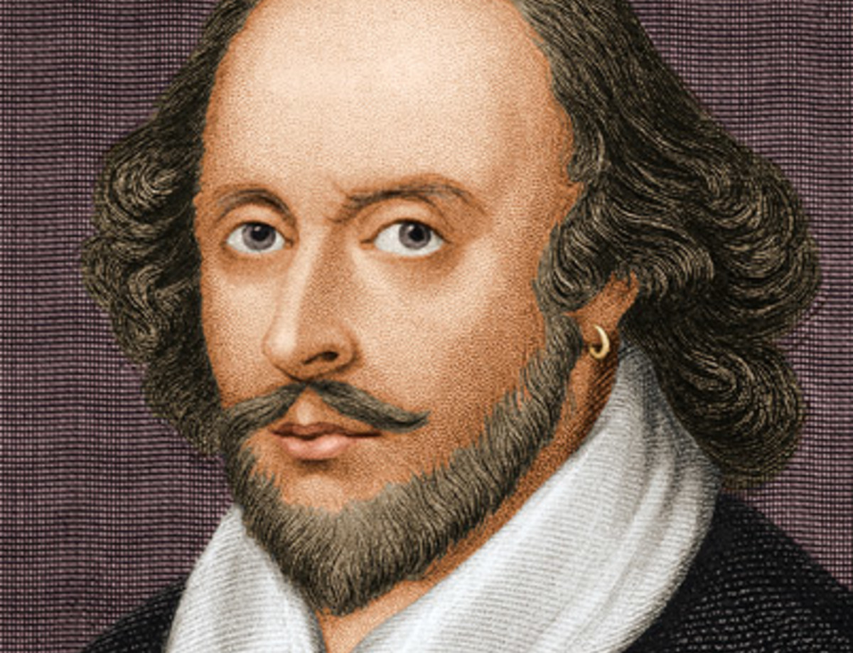
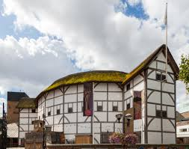

VIRTUAL TOUR OF SHAKESPEARE’S GLOBE THEATRE

Slide 2

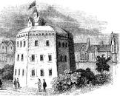
HISTORY OF SHAKESPEARE’S GLOBE THEATRE origin
The Globe Theatre was a theatre in London associated with William Shakespeare. It was built in 1599 by Shakespeare's playing company, the Lord Chamberlain's Men, on land owned by Thomas Brend and inherited by his son, Nicholas Brend and grandson Sir Matthew Brend, and was destroyed by fire on 29 June 1613.

Slide 3
LOCATION OF SHAKESPEARE’S GLOBE THEATRE
Examination of old property records has identified the plot of land occupied by the Globe as extending from the west side of modern-day Southwark Bridge Road eastwards as far as Porter Street and from Park Street southwards as far as the back of Gatehouse Square.^{[7][8]} However, the precise location of the building remained unknown until a small part of the foundations, including one original pier base, was discovered in 1989 by the Department of Greater London Archaeology (now Museum of London Archaeology) beneath the car park at the rear of Anchor Terrace on Park Street.

Slide 4
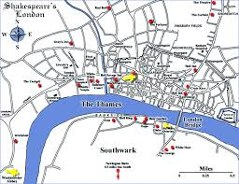
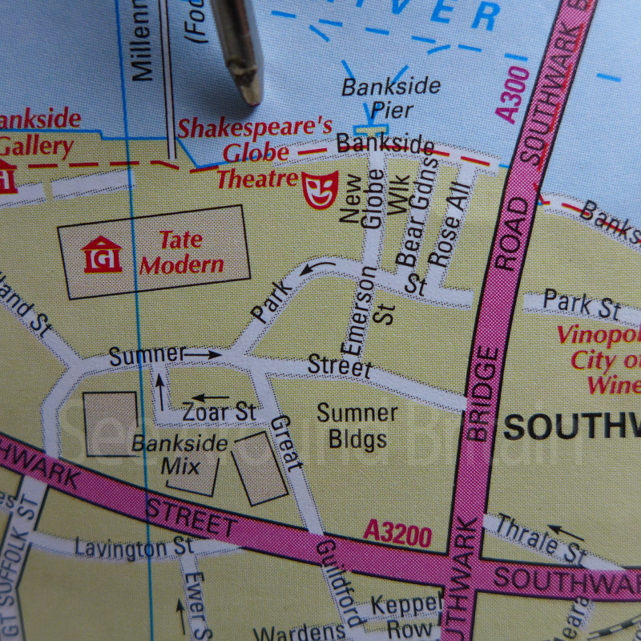

Slide 5
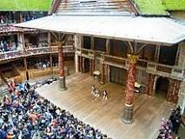
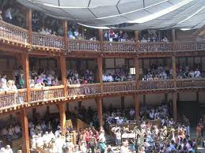
CAPACITY OF SHAKESPEARE’S GLOBE THEATRE
Seating capacity is 873 with an additional 700 "Groundlings" standing in the yard, making up an audience about half the size of a typical audience in Shakespeare's time

Slide 6
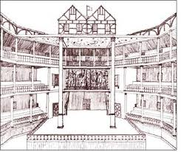
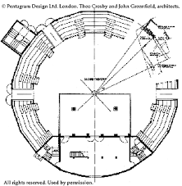
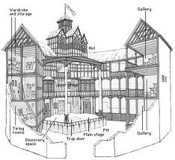
ARCHITECTURE OF SHAKESPEARE’S GLOBE THETRE
The Architect of the Globe Theatre was THEO CROSBY
The Globe Theatre Structure of the interior description is as follows: The arena was called the 'pit' or the 'yard' and had a raised stage at one end which projected halfway into the 'pit' The arena was surrounded by three tiers of roofed galleries with balconies.

Slide 7
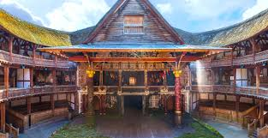
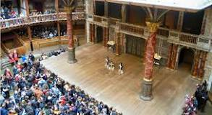
STAGECRAFT OF SHAKESPEARE’S GLOBE THEATRE
Stagecraft refers to all the ways Shakespeare uses his theatrical trade to attain dramatic effects in his works. For example, the language in a Shakespeare play tells us what to read, but it doesn't tell us how to read it.

Slide 8
IMPORTANCE OF MASKS IN SHAKESPEARE’S GLOBE THEATRE
Theatrical uses. Masks have been used almost universally to represent characters in theatrical performances. Theatrical performances are a visual literature of a transient, momentary kind. It is most impressive because it can be seen as a reality; it expends itself by its very revelation
The function of the masks may be magical or religious; they may appear in rites of passage or as a make-up for a form of theatre. Equally masks may disguise a penitent or preside over important ceremonies; they may help mediate with spirits, or offer a protective role to the society who utilise their powers.

Slide 9

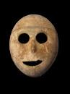
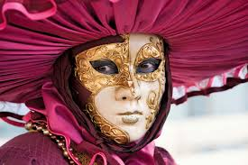
SOME EXAMPLES

Slide 10
Relevance to Modern Day Theatre
The 3 galleries the Globe theatre had back then is still similar to some big theatres today. Gallery seats in theatres today are also generally more expensive than those on the ground floor, so that is similar to Shakespeare’s time as well. The size and seating available is also somewhat similar to the theatres we have today! However, the theatres of the present are so much more comfortable as they are mostly well-sheltered and have seats for everyone. The circular structure is also very similar to the theatres of today as well. It probably made viewing the performance clearer for everyone regardless of which angle they were seated!

Slide 11
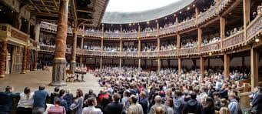
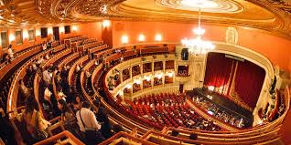
SHAKESPEARE’S GLOBE THEATRE
MODERN DAY THEATRE

Slide 12
PRESENTED BY – DEVRAJ SHARMA CLASS X-C
THANK YOU

